Slide 1
Heart Sound Classifier
Qihua Gong

Slide 2
Introduce
Goal: Using what we have learned in the classroom as a derivative, use machine learning and neural networks to build a model that recognizes different types of abnormal heart sounds.
Get dataset
Signal preprocessing
Feature extraction
The dataset is from a Kaggle competition dataset. It has one type of normal heart sounds and four types of abnormal heart sounds such as AS, MS, MR, and MVP. They are all common heart diseases.
Analysis
Training
Neural network Building

Slide 3
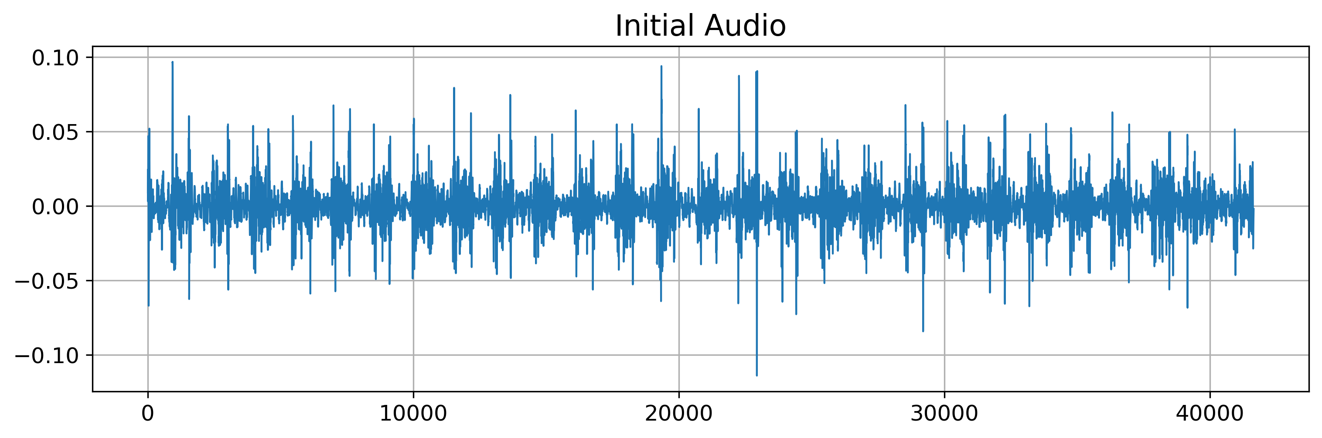
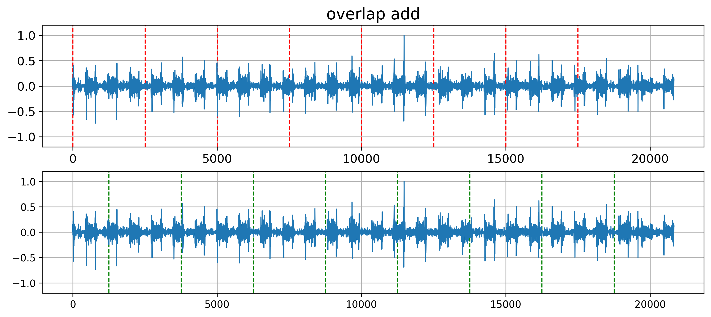
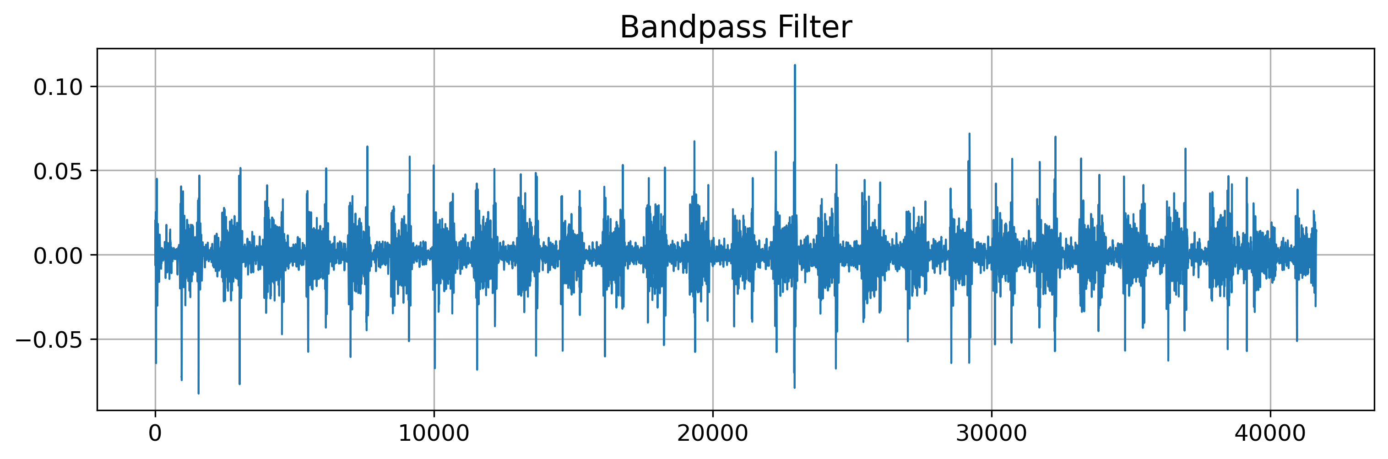
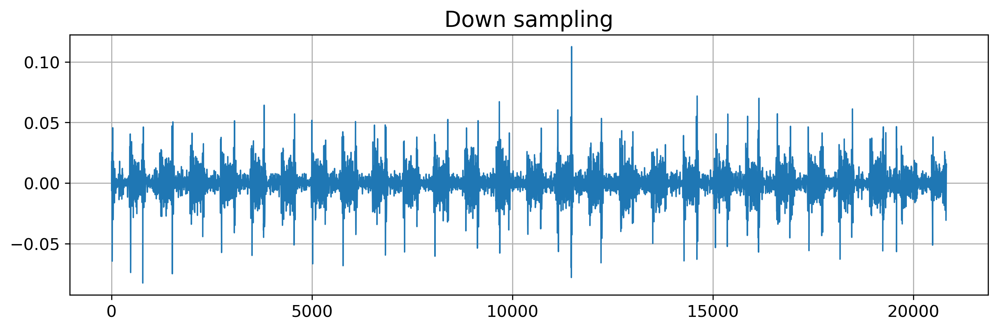
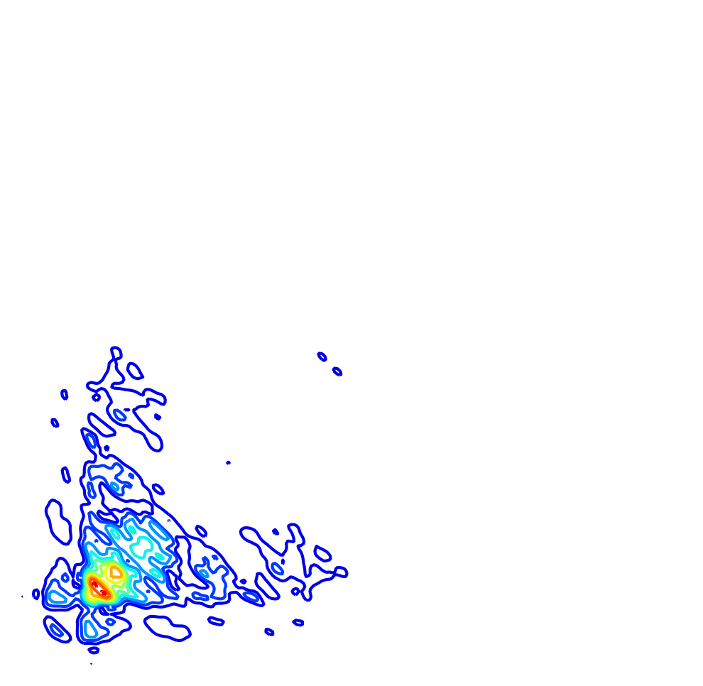
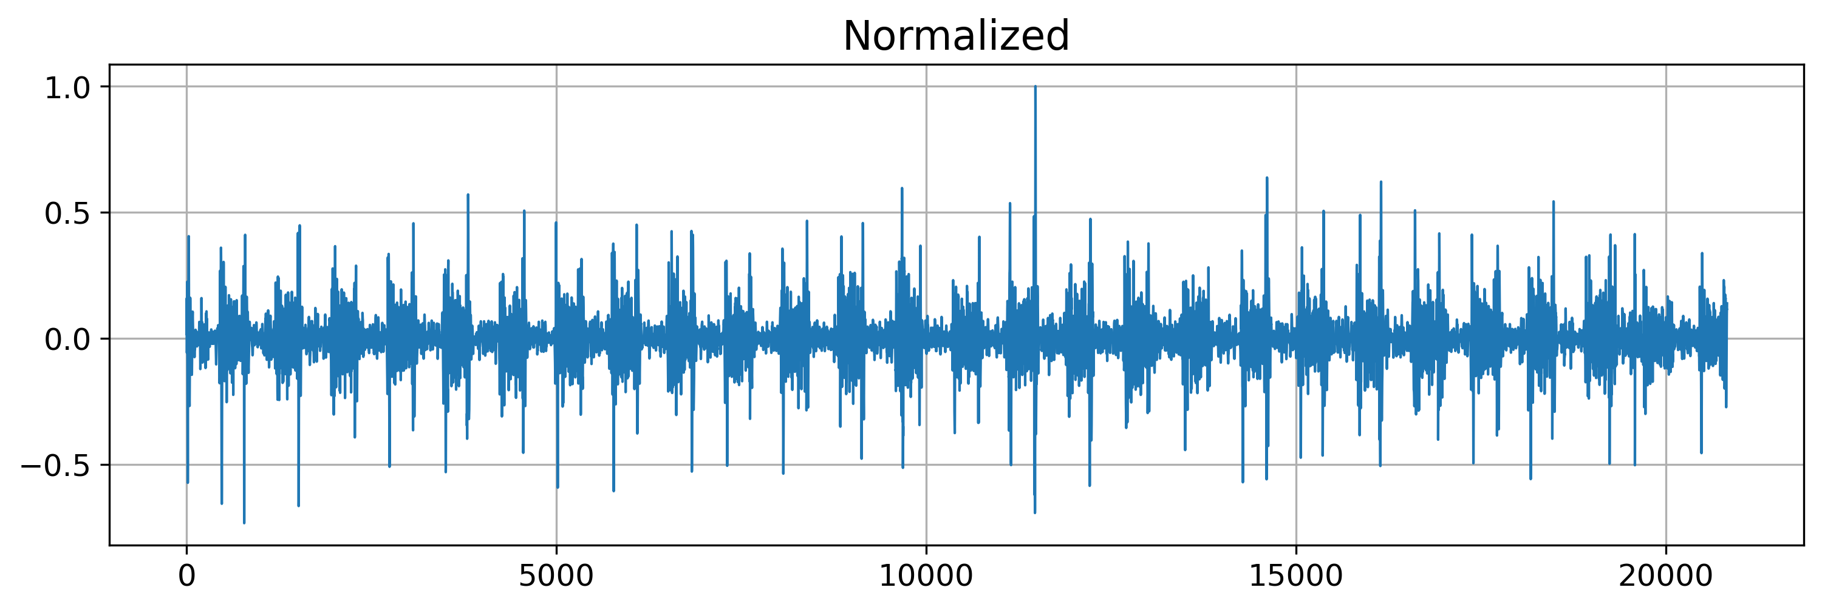
preprocessing
Feature extract
It's method recommend on dealing with such medical audio signal, called second-order spectral (poly spectrum). It can well suppress the phase relationship in the signal, detect and quantify the phase coupling of non-Gaussian signals, and is often used for non-stationary medical signals, such as EEG , ECG, EMG.

Slide 4
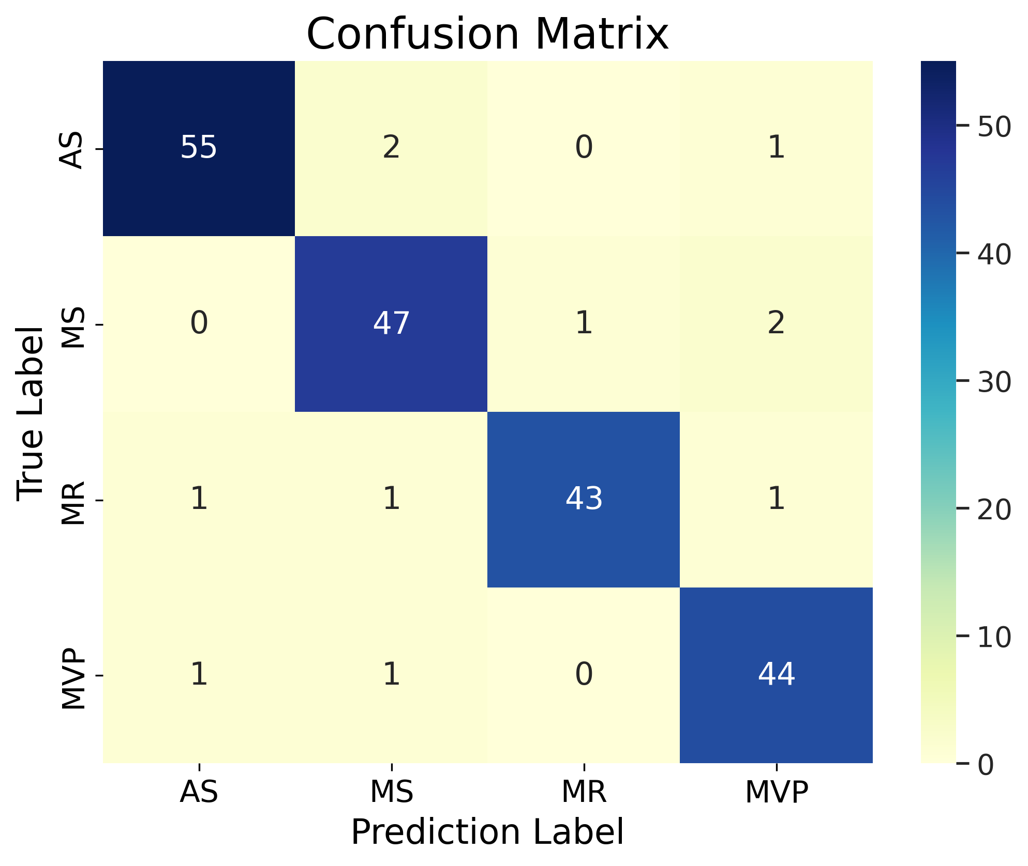
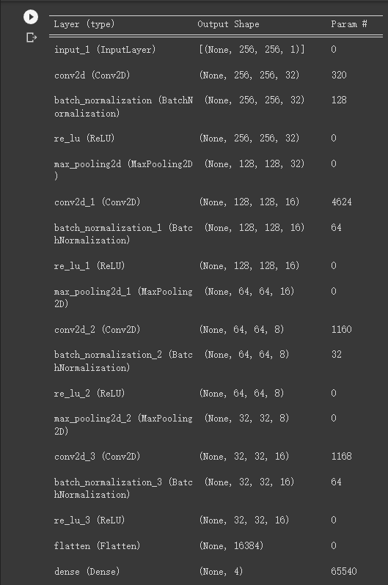
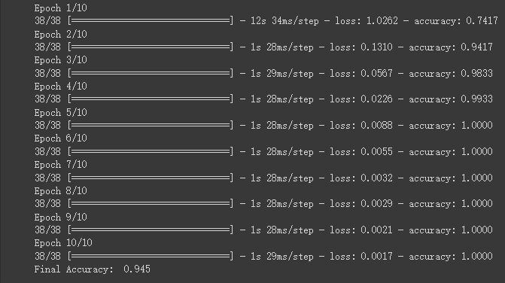
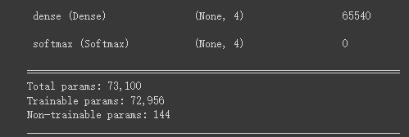
Network build
Training
Result

Slide 5
Thank you

